Slide 1






SPAM EMAIL DETECTION

Slide 2



21CSC203P - ADVANCED PROGRAMMING PRACTICE
RA2211026010433 – MRUGAN KULKARNI
RA2211026010434 – ADITYA GUPTA
RA2211026010442 – REHMAT SINGH CHAWLA

Slide 3





SPAM DETECTOR
JAVA and PYTHON

Slide 4
GUI DESIGN
A GUI, or Graphical User Interface, is a type of user interface that allows users to interact with electronic devices and computer software through graphical elements such as icons, buttons, windows, and menus. GUIs use visual elements to make interaction.
In a GUI, users can perform various tasks by clicking, dragging, and dropping elements on the screen. GUIs are commonly used in operating systems (e.g., Microsoft Windows, macOS, Linux with graphical desktop environments) to be more intuitive and user-friendly.
GUIs are intuitive and user-friendly, making it easier for people to interact with computers and software. They provide a visual representation of the tasks and options available, which is more understandable for most users. GUIs also enable users to work with multiple applications simultaneously, thanks to the use of Windows.

Slide 5
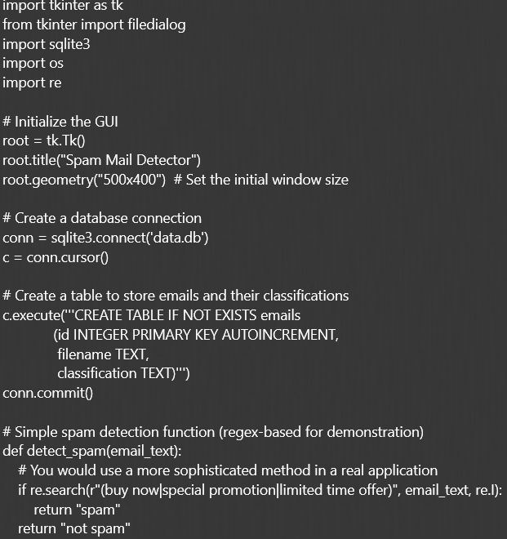
PYTHON CODE

Slide 6
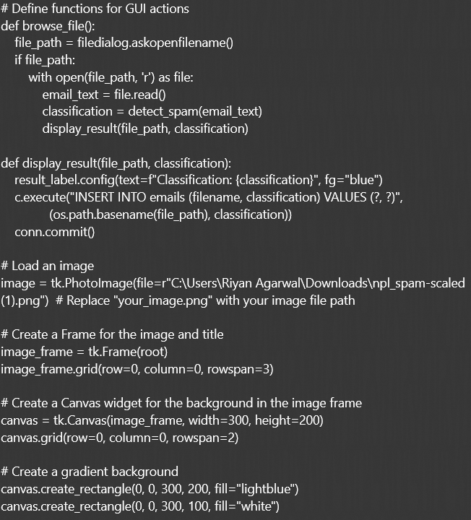

Slide 7
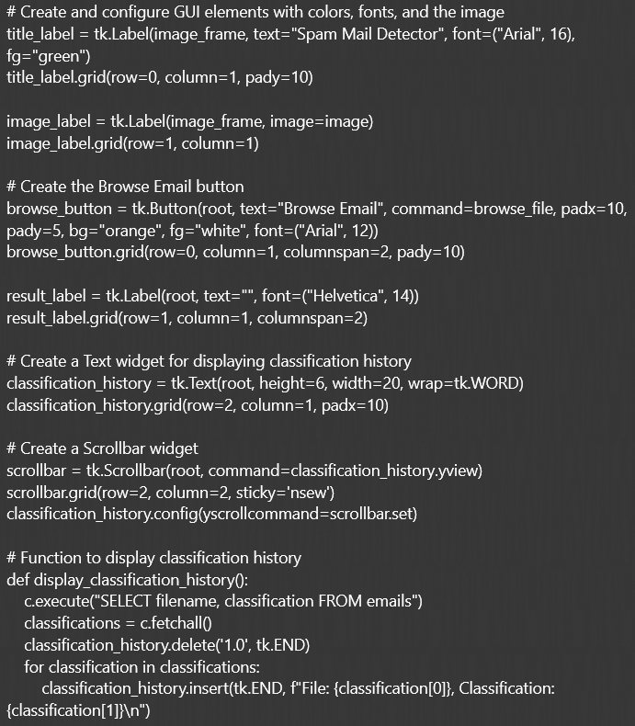

Slide 8
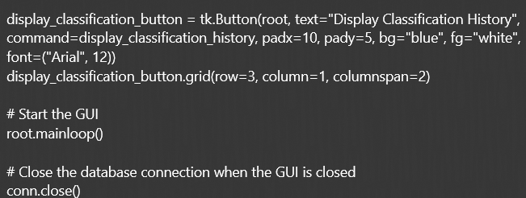

Slide 9
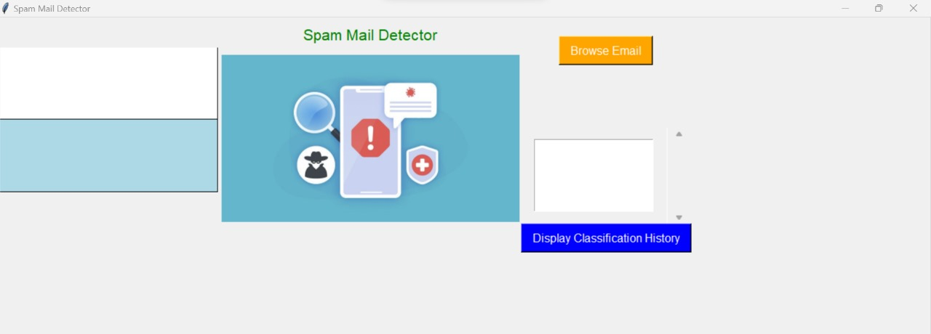

Slide 10
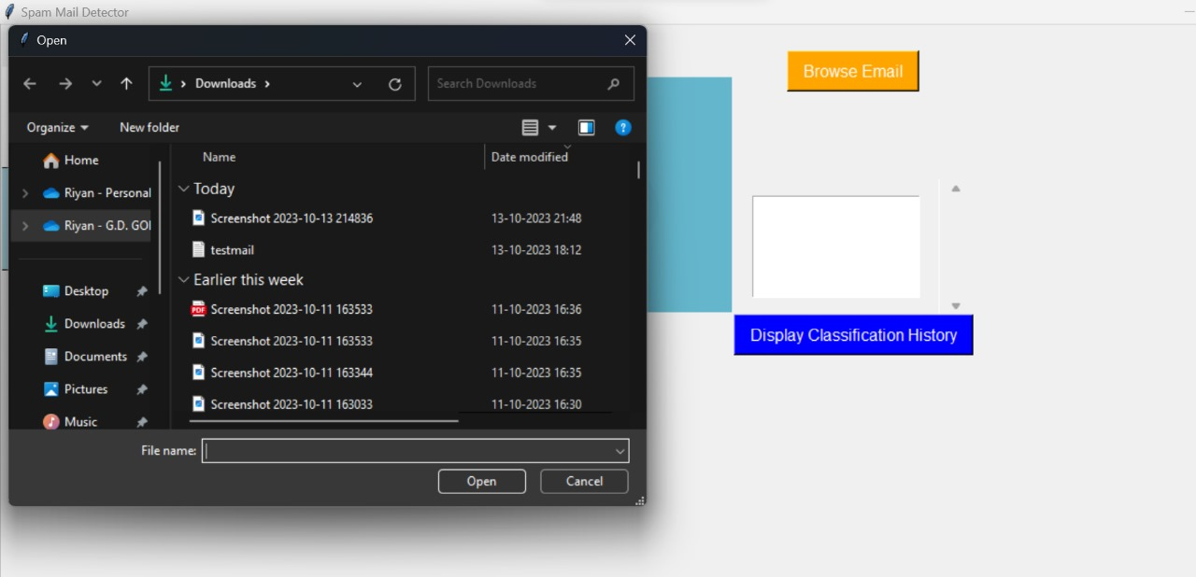

Slide 11
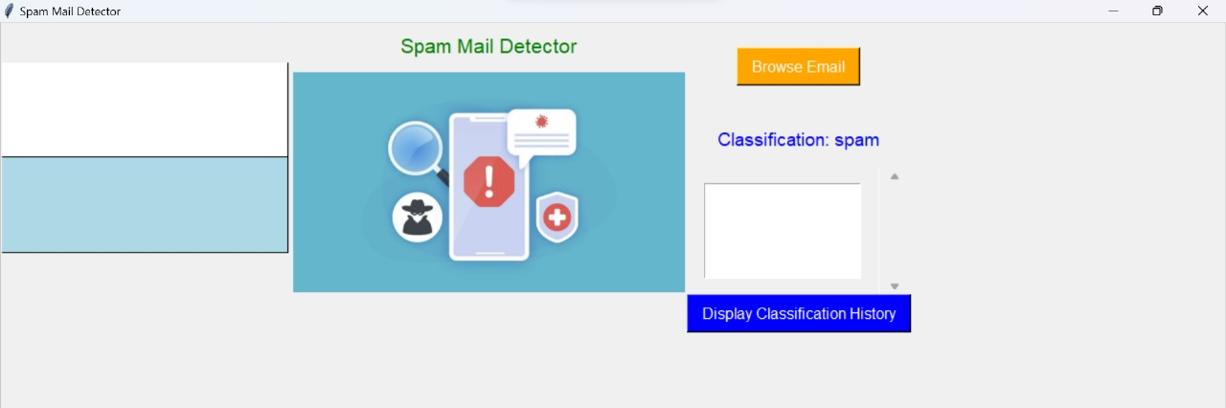

Slide 12
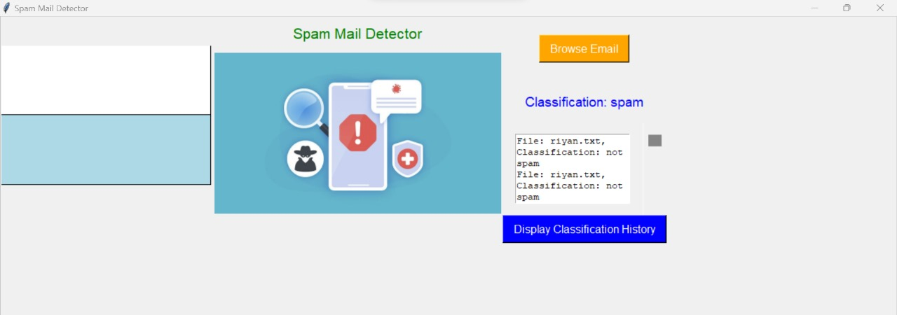

Slide 13
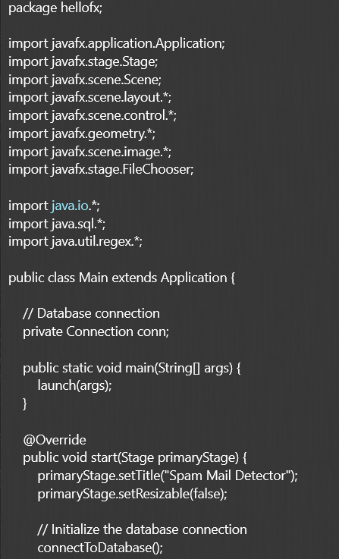
JAVA CODE

Slide 14
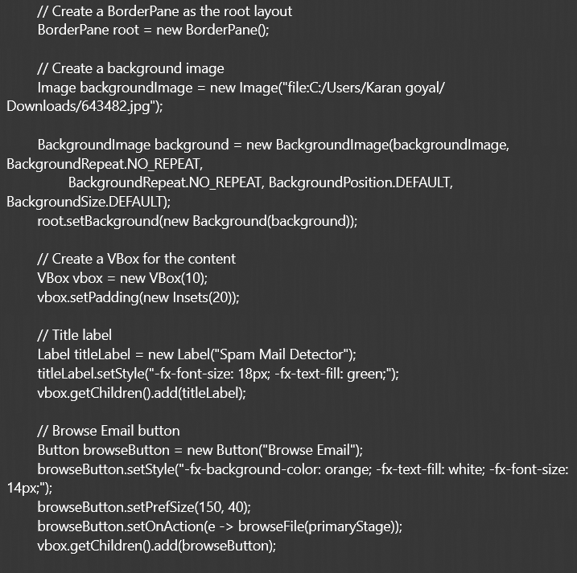

Slide 15
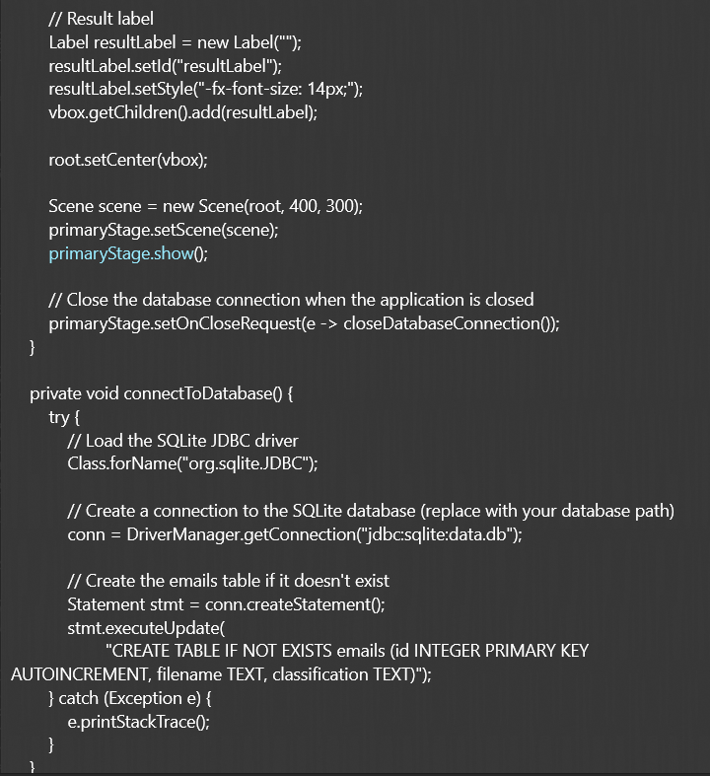

Slide 16
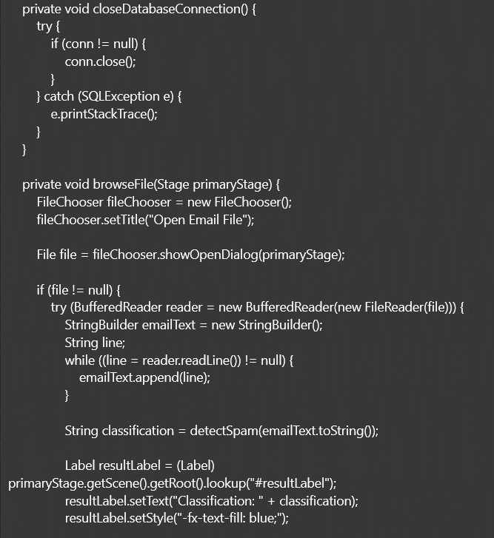

Slide 17
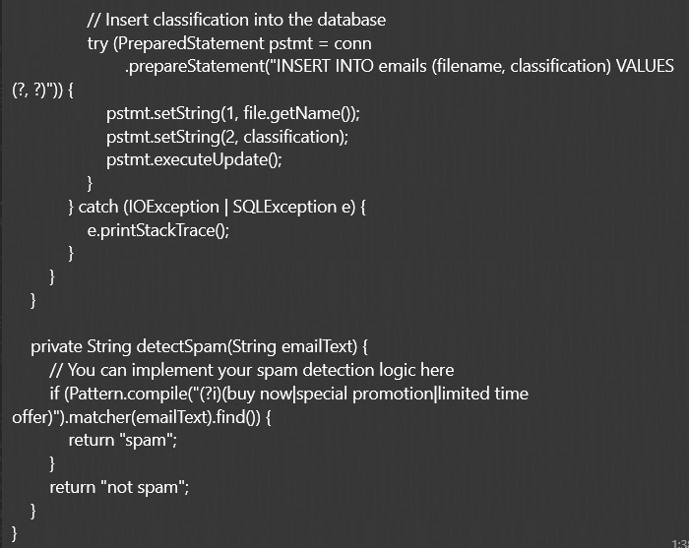

Slide 18
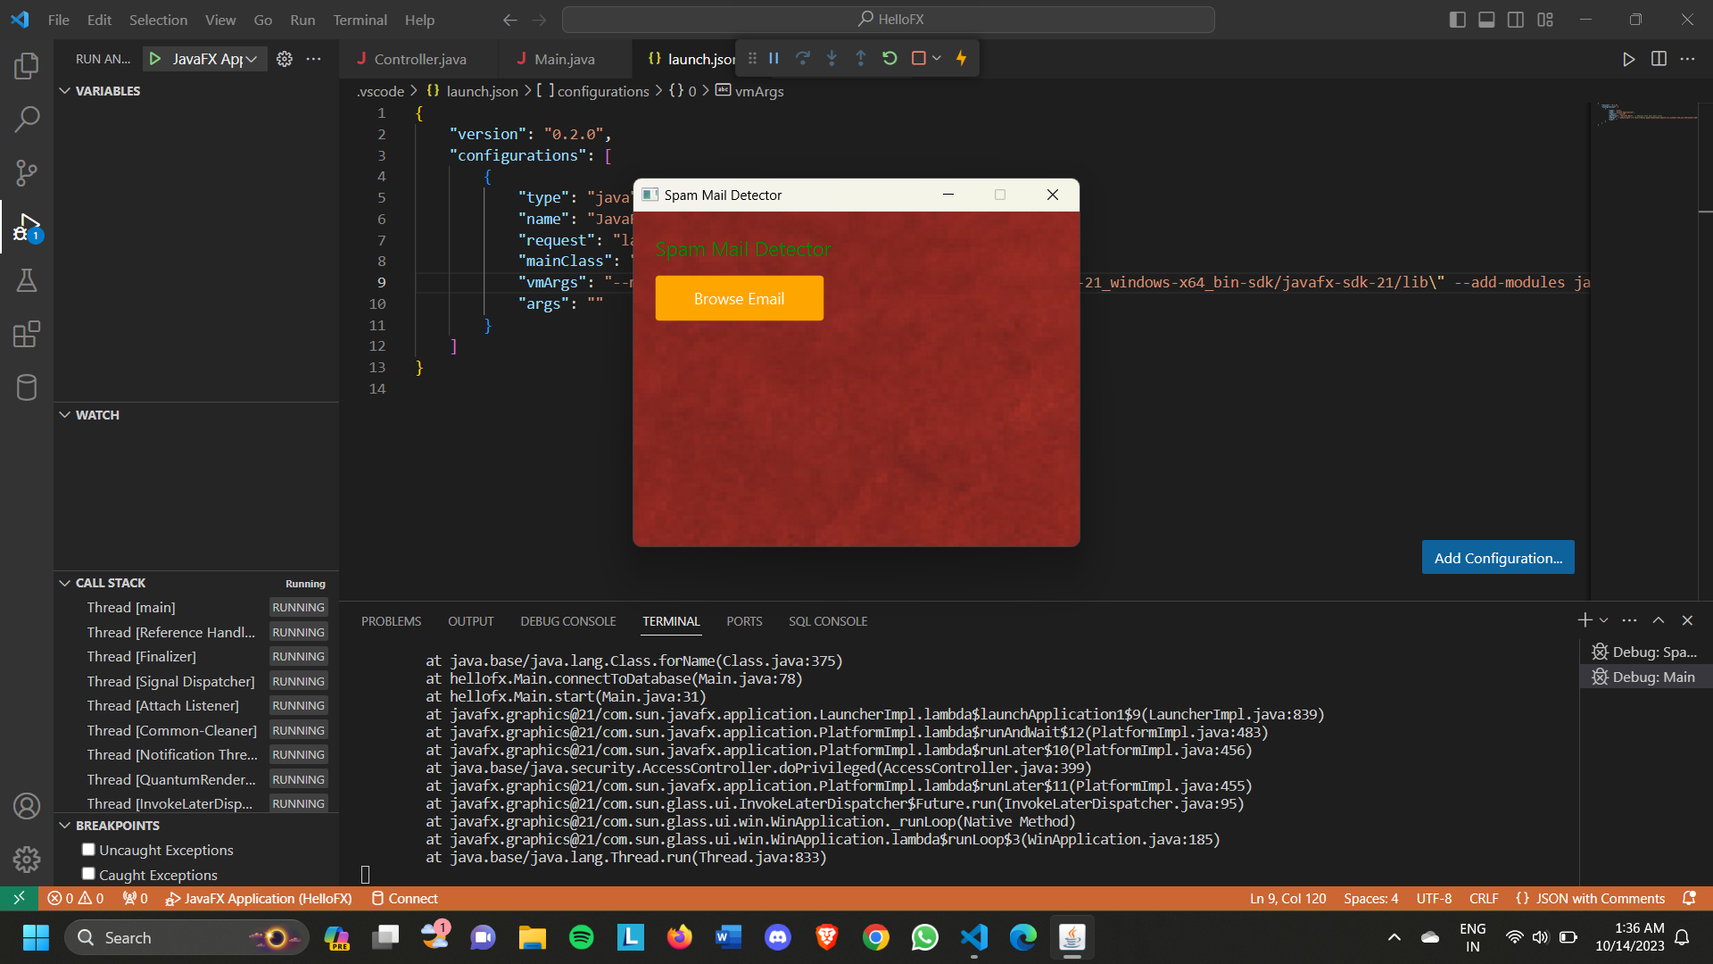

Slide 19
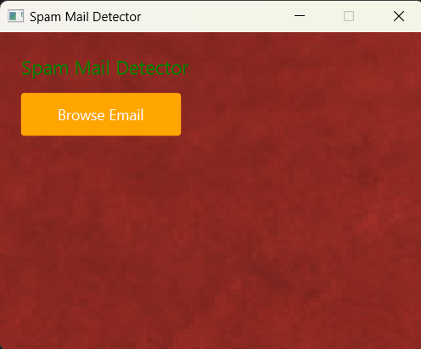

Slide 20
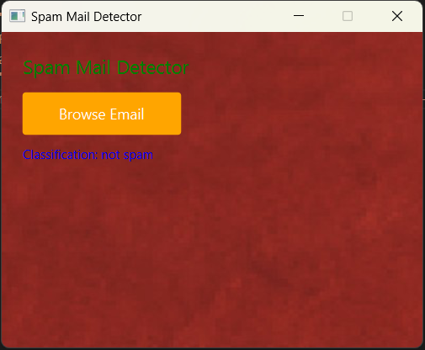

Slide 21
DATABASE DESIGN
Database design is the process of creating a structured plan for how data will be stored, organized, and accessed in a database management system (DBMS).
It involves defining the database's structure, tables, relationships, and constraints to ensure efficient data storage, retrieval, and maintenance. A well-designed database is crucial for managing and manipulating data effectively.
Databases play a crucial role in managing and organizing large volumes of data in a structured and efficient manner. They are essential in various applications, ranging from business operations and scientific research to web development etc..
For example… Relational Databases: These databases store data in tables with rows and columns. They are known for their structured data and use SQL (Structured Query Language) for querying and managing data. Popular relational database management systems (RDBMS) include MySQL, PostgreSQL, Oracle, and Microsoft SQL Server.

